Slide 1
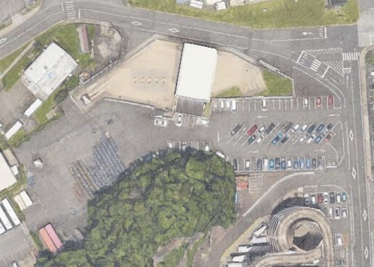
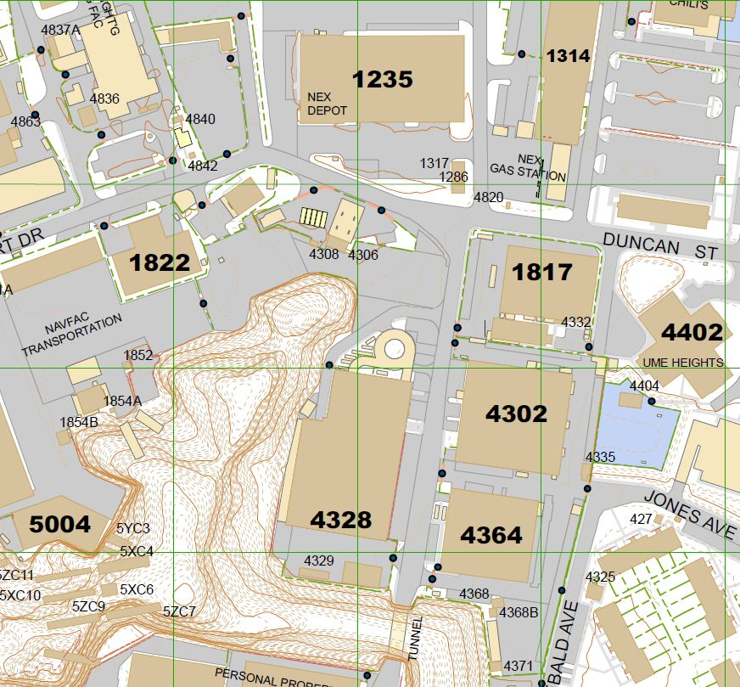
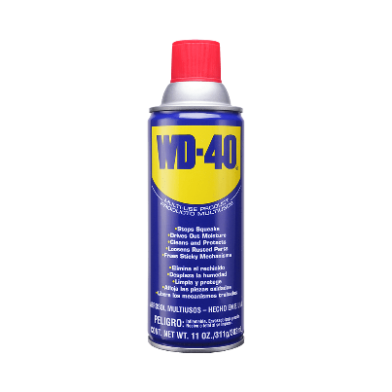
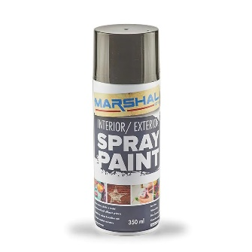
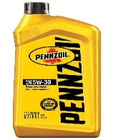
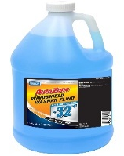
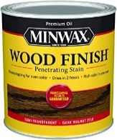
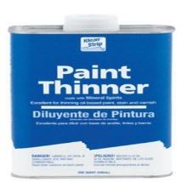
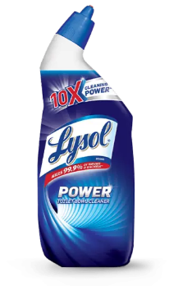
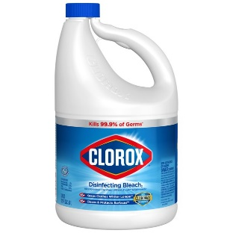
HOUSEHOLD HAZARDOUS PRODUCT REUSE PROGRAM PCS In or Out | Spring Cleaning | Free Products
5 Jan 2023
Products can be hazardous if they contain ingredients which are: Corrosive, Toxic, Ignitable, or Reactive
Improper disposal, such as pouring them down the drain, on the ground, or into storm sewers causes harm to the environment and endangers human health.
DROP OFF excess or unwanted household hazardous products.
PICK UP free household hazardous products.
US products only
(no Japanese products)
Original containers:
closed, clean and not leaking
New and partially used (at least half full)
If available, bring Safety Data Sheet (SDS)
Located in parking lot at Duncan St. and Rickert St., behind Govt Gas Station
M, W, F (9:00 – 11:00)
T, Th (13:00 – 15:00)
*** Refer to Turn-In Guide for examples ***
Govt Gas Station
Duncan St.
Walk
Park
Rickert Dr.
Reuse
NEX
Autoport
Duncan St.
PWD
Rickert Dr.
Questions?
Please feel free to contact Public Works Department Environmental Branch
070-7411-1294 (Cell) 046-816-4100 (Comm) 243-4100 (DSN)

Slide 2
COMMON WASTE
TURN-IN GUIDE
5 Jan 2023
All phone numbers listed DSN; commercial 046-816-xxxx
Household Hazardous Material Reuse Program operated by CFAY Public Works Department (PWD)
Stains & wood finishes Pesticides & herbicides Odor remover spray Oven cleaner Multi cleaner Sanitize spray & hand sanitizer Bar soap Isopropyl alcohol & bleach Only U.S. products in original containers All free acceptance |  | Parking Lot at Duncan St. and Rickert Dr. (behind Govt Gas Station) Phone #: 243-4100 Open: 09:00 – 11:00 M, W, F 13:00 – 15:00 T, Th
Car Care Center operated by Navy Exchange (NEX)
Flare Propane gas tank 5GL Car battery | Coolant Kerosene Diesel Engine oil | Bldg. 1314 (behind NEX Autoport) Phone #: 243-4778 / -5826 Open: 07:30 – 17:00 M – F 07:30 – 16:00 Sat
Some free acceptance; some charged
Auto Skills Center (Auto Hobby Center) Operated by CFAY Morale Welfare and Recreation (MWR)
Tire All automobile oil (engine, brake, transmission) Coolant Car battery No acceptance of fuel or & lead acid batteries |  | Bldg. 1288 (behind NEX Autoport) Phone #: 243-5456 Open: 11:00 – 19:00 M, Th, F 09:00 – 17:00 Sat, Sun
Qualified Recycling Program (QRP) operated by CFAY Public Works Department (PWD)
Lithium Ion (Li-ion) batteries for cell phone Lead Acid Batteries Nickel -Metal Hydride (NiMH) batteries for computers Cooking oil, car oil & kerosene White paper, cardboard, textiles & scrap metal All free acceptance |  | Bldg. 4856 (behind NEX Depot Store) Phone #: 243-3817 / -5806 Open: 08:00 – 15:30 M – F
Questions?
Please feel free to contact Public Works Department Environmental Branch
070-7411-1294 (Cell) 046-816-4100 (Comm) 243-4100 (DSN)

